Slide 1

Python爬蟲技術與資料擷取

Slide 2

Agenda

Slide 3

Python爬蟲套件|模組

Slide 4

Python爬蟲 套件|模組
內建模組 urllib urllib2 requests模組 lxml模組 Scrapy模組

Slide 5


設計爬蟲程式探索下列相關網站：
☆：國際與國內股市資訊
☆：基金資訊
☆：股市數據
☆：人力銀行
☆：維基網站
☆：主流媒體網站
☆：政府開放數據網站
☆：YouBike服務網站
☆：PTT網站
☆：電影網站
☆：星座網站
☆：小說網站
☆：博客來網站
☆：中央氣象局
☆：露天拍賣網站
☆：httpbin網站
☆：python.org網站
☆：github.com網站
☆：ipstack.com網站API實作
☆：Google API實作
☆：Facebook API實作
探索網站成功後，筆者也說明下列如何下載或儲存不同資料格式的數據：
★：CSV檔案格式
★：JSON檔案格式
★：XML、Pickle
★：Excel
★：SQLite
以後
MYSQL
REDIS
MONGODB
相關問題解決：
☆：URL編碼與中文網址觀念
☆：將中文儲存在JSON格式檔案
☆：亂碼處理
☆：簡體中文在繁體中文Windows環境資料下載與儲存
☆：解析Ajax動態加載網頁，獲得更多頁次資料
☆：使用Chromium瀏覽器協助Ajax動態加載

Slide 6
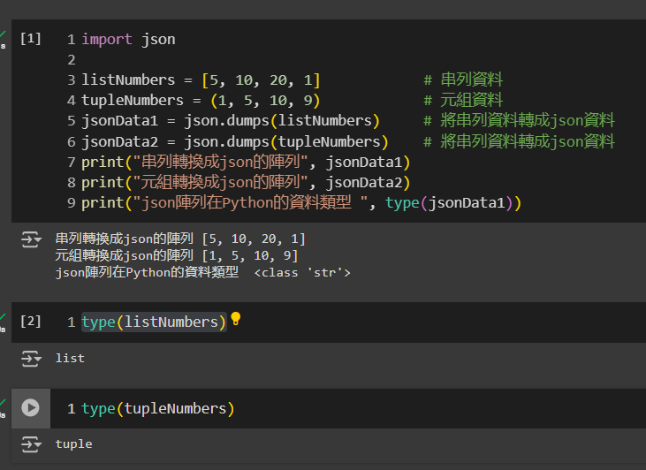
ch1_1.py

Slide 7
Selecting visual aids
Enhancing your presentation

Slide 8
Effective delivery techniques
This is a powerful tool in public speaking. It involves varying pitch, tone, and volume to convey emotion, emphasize points, and maintain interest.
Pitch variation
Tone inflection
Volume control
Effective body language enhances your message, making it more impactful and memorable.
Meaningful eye contact
Purposeful gestures
Maintain good posture
Control your expressions

Slide 9
Navigating Q&A sessions
Know your material in advance
Anticipate common questions
Rehearse your responses
Maintaining composure during the Q&A session is essential for projecting confidence and authority. Consider the following tips for staying composed:
Stay calm
Actively listen
Pause and reflect
Maintain eye contact

Slide 10

Speaking impact
Your ability to communicate effectively will leave a lasting impact on your audience
Effectively communicating involves not only delivering a message but also resonating with the experiences, values, and emotions of those listening

Slide 11
Dynamic delivery
Learn to infuse energy into your delivery to leave a lasting impression
One of the goals of effective communication is to motivate your audience
Impact factor | Measurement | Target | Achieved
Audience interaction | Percentage (%) | 85 | 88
Knowledge retention | Percentage (%) | 75 | 80
Post-presentation surveys | Average rating | 4.2 | 4.5
Referral rate | Percentage (%) | 10 | 12
Collaboration opportunities | # of opportunities | 8 | 10

Slide 12
Final tips and takeaways
Consistent rehearsal
Strengthen your familiarity
Refine delivery style
Pacing, tone, and emphasis
Timing and transitions
Aim for seamless, professional delivery
Practice audience
Enlist colleagues to listen & provide feedback
Seek feedback
Reflect on performance
Explore new techniques
Set personal goals
Iterate and adapt

Slide 13
Speaking engagement metrics
Impact factor | Measurement | Target | Achieved
Audience interaction | Percentage (%) | 85 | 88
Knowledge retention | Percentage (%) | 75 | 80
Post-presentation surveys | Average rating | 4.2 | 4.5
Referral rate | Percentage (%) | 10 | 12
Collaboration opportunities | # of opportunities | 8 | 10

Slide 14

Thank you
Brita Tamm
502-555-0152
brita@firstupconsultants.com
www.firstupconsultants.com

